Slide 1
Broadcast Technology UG1
1: Introduction; The Industry
Leo Wang: yonghao.wang@bcu.ac.uk
Thanks:
De Mi, Berna Bulut, Jermery Foss
De.Mi@bcu.ac.uk; Berna.Bulut@bcu.ac.uk ; Jeremy.Foss2@bcu.ac.uk

Slide 2
Learning Outcomes
1. Differentiate between TV audio and video standards and apply for studio applications
2. Evaluate and select data interconnects for audio and video
3. Select and apply test procedures for audio and video signals
4. Compare and contrast network transmission standards worldwide, current and legacy, and evaluate for application to broadcast developments

Slide 3
SCHEDULE (Planned)
Date |  | Time | Where
16 March | 1 | 9-12 | CCZ269 | Introduction, Market and Development
23 March | 2 | 9-12 | CCZ269 | Signals
24 March | 3 | 9-12 | CCZ312 | Transmission Media
25 March | 4 | 9-12 | CMP168 | Electrics, Shielding, Connectors
26 March | 5 | 9-12 | CMP211 | Modulation and Multiplexing
13 April | 6 | 9-12 | CCZ269 | Gamma, OOTF, PQ
14 April | 7 | 9-12 | CCZ312 | SDI; Video Test and Measurement
15 April | 8 | 9-12 | CMP168 | Packet Media, Compression
16 April | 9 | 9-12 | CMP211 | Compression (cont’d), Packet Media Transport
21 April | 10 | 9-12 | online | The Legacy of Analogue; Light and Control
27 April | 11 | 9-12 | CCZ269 | TV Standards
5 May | 12 | 9-12 | online | Network media
12 May | 13 | 9-12 | online | Media Distribution Networks
20 May | 14 | 13-16 | CMP211 | Media Distribution Networks (cont’d), Broadcast Workflow
21 May | 15,16 | 9-12; 13-16 | CMP211 |  | New Topics and Module Review
22 May | 17 | 9-12; | CMP211 | EXAM

Slide 4
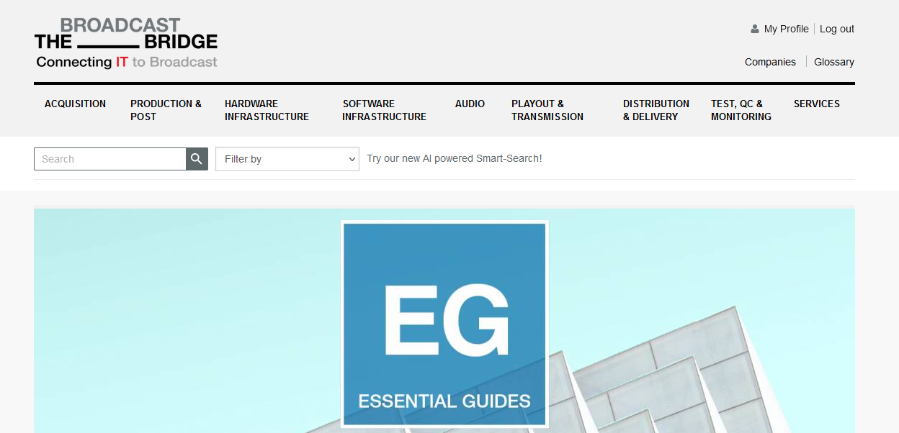
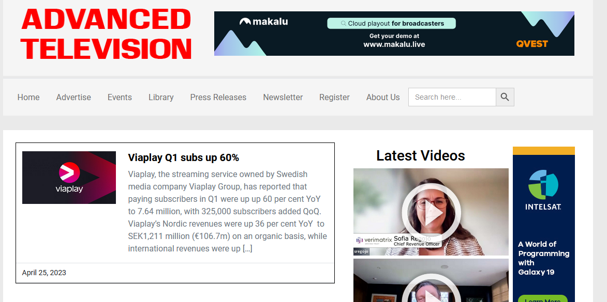
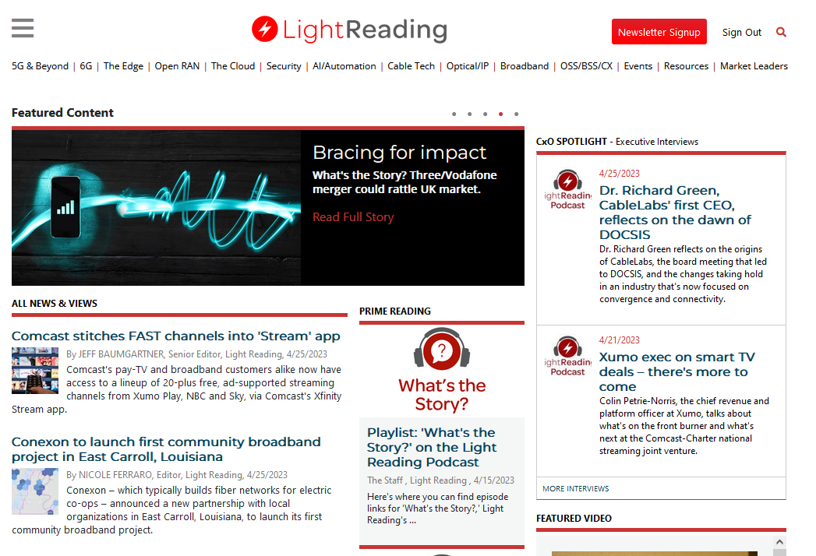
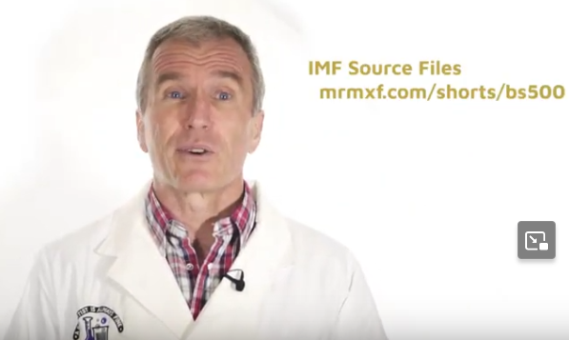

Some Resources
Broadcast Bridge
https://www.thebroadcastbridge.com/
Advanced Television
https://advanced-television.com/
Light Reading
https://www.lightreading.com/
Bruce's shorts
https://mrmxf.com
Dalet Academy on YouTube
SMPTE Motion imaging
https://www.smpte.org/

Slide 5
ASSESSMENT
The assessment for this module will be one exam
(i.e. an exam which accounts for 100% of the final module mark)
Exam date: Wednesday 25th June (on-campus)
You are required to answer FOUR of the SIX questions
Questions will have a number of parts (typically 3, 4 or 5)
Marks breakdown is shown in brackets
Each question carries 25 marks; total marks for the paper = 100
Pass Mark: 40%
Note that marks are allocated for method, in addition to the final answer.
Therefore method and full calculations should be shown in your solutions to analytical questions.
Calculators may be used provided they are in accordance with Faculty guidelines.
Reassessment
Date - tbc
(same format as the original assessment)

Slide 6
Introduction to the Module:
The Market
(or some of it)
You are all marketers now …

Slide 7
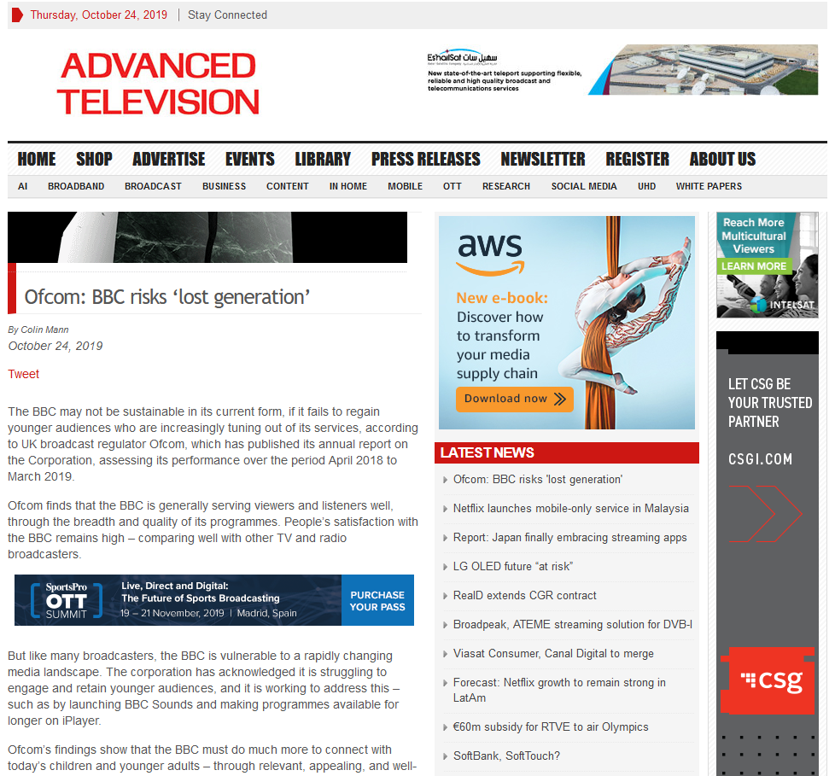
https://advanced-television.com/2019/10/24/ofcom-bbc-risks-lost-generation/
The BBC may not be sustainable in its current form, if it fails to regain younger audiences who are increasingly tuning out of its services, according to UK broadcast regulator Ofcom …
… like many broadcasters, the BBC is vulnerable to a rapidly changing media landscape.
… acknowledged it is struggling to engage and retain younger audiences
… working to address this
… BBC Sounds
… programmes available for
longer on Player

Slide 8
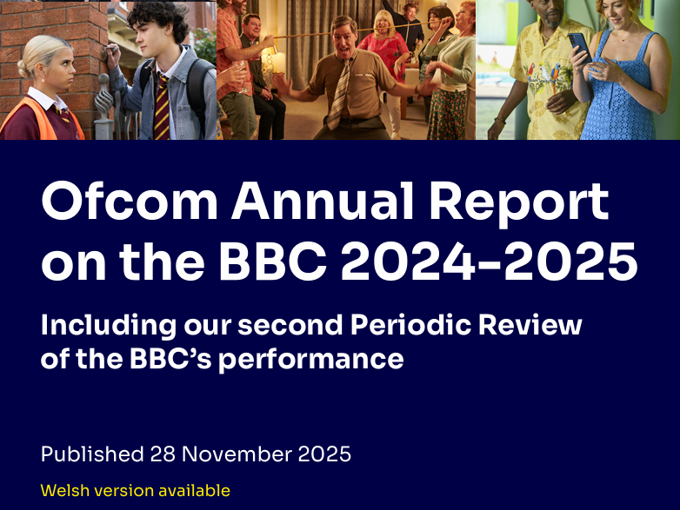
Ofcoms Annual Report on the BBC 2024-25
BBC and the Changing Media Landscape Ofcom Annual Report on the BBC (2024-2025)
Key issues:
Audience behaviour shifting to online and global platforms
BBC share of media time fell from 36% (2015) to 22% (2024)
Younger audiences remain harder to engage
BBC responding with:
Digital-first strategy
expansion of iPlayer and BBC Sounds
distribution on YouTube and TikTok
digital news services
Despite competition:
83% of UK adults still use BBC services weekly
BBC remains the UK’s most trusted news provider

Slide 9
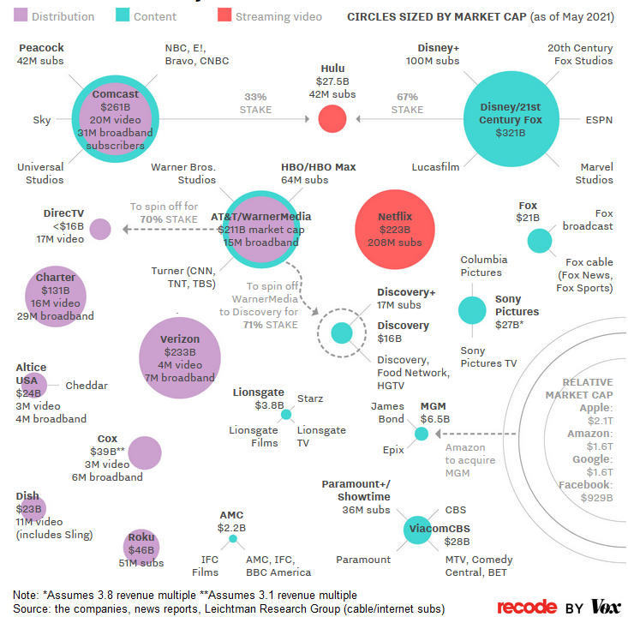
Media Landscape
The Broadcast Industry Used to be Straightforward (!):
Content companies – studios
… made shows and movies
… sold it to distributors
… who sold it to consumers
(via various direct broadcast or via affiliates, etc)

Slide 10
Media Landscape
Now
Netflix buys from studios
also makes own stuff
sell directly to consumers
Traditional media companies
compete by consolidating
Disney purchase of 21st Century Fox
Distributors like AT&T
bought Time Warner …
becoming media companies, too
Giant tech -
- Google, Amazon, Apple
also becoming media companies
Apple now position as
a TV guide / storefront .. sell services like HBO
a TV creator .. exclusive shows for Apple users
https://www.vox.com/2018/1/23/16905844/media-landscape-verizon-amazon-comcast-disney-fox-relationships-chart

Slide 11
Media Industry Transformation
2010: Broadcast Era | 2025: Platform Era
TV channels dominate distribution | Platforms dominate distribution
Cable & satellite control access | Smart TVs, apps, mobile platforms
Media companies own audiences | Platforms control audience attention
National broadcasting markets | Global streaming competition
Content scheduled by broadcasters | Content delivered on-demand

Slide 12
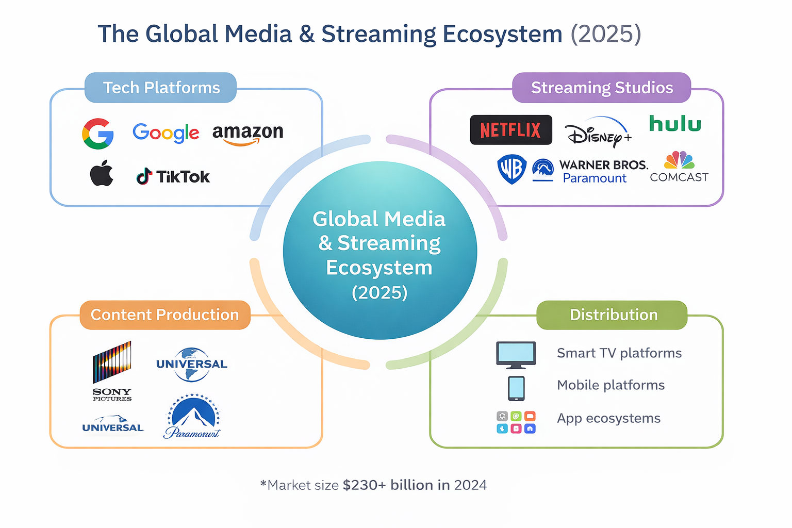
Notes:
The Global Media & Streaming Ecosystem (2025)
1. From Broadcasting to Platform Competition
The global media industry has shifted from a broadcast-centric model to a platform-based ecosystem.
Traditional broadcasters once controlled both content production and distribution, but today audiences increasingly access media through digital platforms and streaming services.
2. Technology Companies at the Core of Media
Technology companies now play a central role in the media ecosystem.
Platforms such as Google (YouTube), Amazon (Prime Video), Apple (Apple TV+) and TikTok control major channels of audience attention and content distribution.
These companies combine technology infrastructure, data, and global platforms, allowing them to compete directly with traditional media companies.
3. The Second Phase of the Streaming Wars
The industry is entering a new phase of the streaming wars.
After a period of launching new streaming services, the focus is now shifting towards scale, profitability, and consolidation.
Large streaming platforms such as Netflix, Disney+, Prime Video and Warner Bros Discovery compete globally for subscribers, intellectual property, and exclusive content.
4. The Key Players in the 2025 Media Ecosystem
The ecosystem can be understood through four interacting layers:
Technology Platforms Google, Amazon, Apple, TikTok
Streaming Studios Netflix, Disney, Warner Bros Discovery, Comcast
Content Production Sony Pictures, Universal Studios, Paramount
Distribution Channels Smart TVs, mobile platforms, and global app ecosystems
Key Insight
The modern media landscape is no longer dominated by traditional broadcasters. Instead, it is shaped by the interaction between technology platforms, global streaming services, and large content producers.

Slide 13
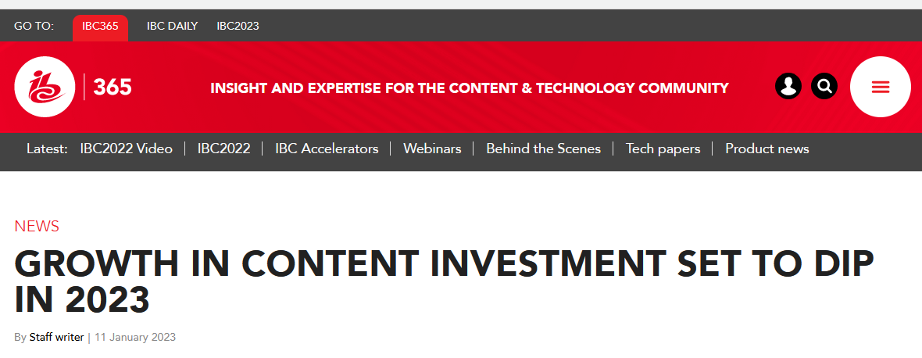
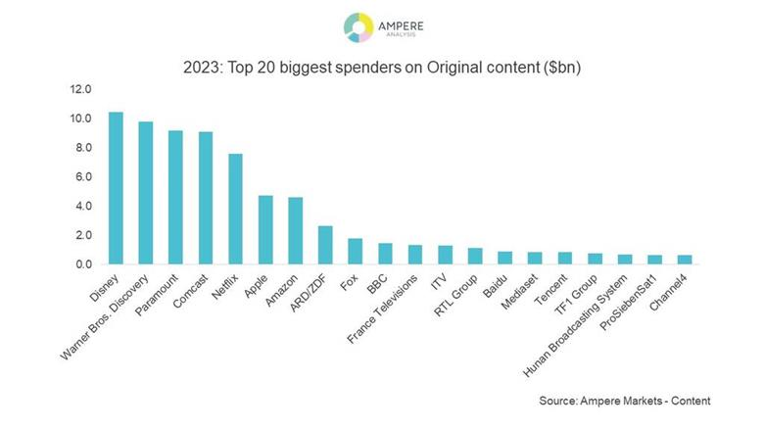
Content Investment in the Streaming Era- Ampere Analysis
https://www.ibc.org/news/growth-in-content-investment-set-to-dip-in-2023/9381.article
Growth in global content spending has slowed after the rapid expansion of the streaming wars.
the lowest growth in over a decade
(excluding the COVID-driven slump of 2020)
One year global content spend grew by 6%
to $238Bn
driven primarily by SVOD platforms
SVOD collectively spent over $26bn on original content in 2022
(but FAST and AVOD are rapidly growing)
SVOD: Subscription VoD
AVOD: Advertisig VoD
TVOD: Transactional VoD (pay/view)
FAST: Free Ad-supported linear channels to mass audience
continued …

Slide 14
Ampere analysis continued …
Economic Situation
pressure on household spending and advertising investment
more cost-saving, reduce content expenditure
Netflix - first global decline in subscribers
(their content investment plateaued in 2023)
Uneven:
Some groups will increase investment
others will cut back
Disney and Warner Bros Discovery will overtake Comcast and its subsidiaries
become the leading investors in original content
Disney to reach $10.5bn; Warner Bros Discovery > $9.5bn
Netflix continue to lead dedicated SVOD spend
> 25% of global SVOD original content investment
https://www.ibc.org/news/growth-in-content-investment-set-to-dip-in-2023/9381.article

Slide 15
Streaming Industry Update (2025/26)
Economic Situation
Growth in global content spend slowed to 0.4% in 2025
Platforms are shifting from subscriber growth to profitability
Advertising-supported models are becoming more important
Netflix subscriber decline proved temporary → now 300M+ global subscribers
Uneven
VoD spend reached $95bn in 2025 and overtook commercial broadcasters
YouTube is now the largest TV distributor by watch time (12.4%) Netflix, Disney and Amazon remain the key global players
Industry Trend
The streaming industry has shifted from expansion to consolidation and platform competition.

Slide 16

Top Trends: FAST, AI, Virtual production and more
https://www.ibc.org/features/top-10-trends-of-2022-fast-ai-virtual-production-and-more/9346.article
FAST - Free Ad-Supported Streaming TV
SVOD subscriber curve begins to flatten
FAST offers extended reach, ad revenue stream, and the opportunity to recruit linear TV users
OTT discussion continues
Grew in 2022
cross-industry debate over monetisation strategies and emerging business models
OTT will be a fixture for some time to come
Sustainability drive goes up a gear
media and broadcast industry has been actively engaged in sustainability
Production-based Albert programme
Green Production Guide, plus generating awareness across the value chain
continued …

Slide 17
Top Trends continued
Market consolidation continues (a lot of it in 2022)
Discovery + AT&T’s WarnerMedia, $43 billion
Brought together brands including Discovery Channel, discovery+,
Warner Bros. Entertainment, CNN, CNN+, DC, Eurosport, HBO etc
AI beginning to deliver value
Practical use cases beginning to emerge.
e.g. AI analytics deliver high granularity of insight into audiences
automating metadata
video processing - e.g. World Cup in Qatar
Virtual production gathers pace
e.g. Epic Games’ Unreal Engine use in virtual production, and other advances
5G continues to inspire
5G connectivity in OB and news; 5G remote production
Cloud maturing fast
actively used by a large proportion of content creators and rights holders
benefits: media supply chain, flexible working, remotely with experts, producers to editors, colorists to production teams, distribution of content globally, rapidly and efficiently
https://www.ibc.org/features/top-10-trends-of-2022-fast-ai-virtual-production-and-more/9346.article

Slide 18
What to Expect
Rise in AVOD and FAST set to continue
Driven by mixed financial outlook
SVOD cancellations ⇨ a potential benefit for FAST and AVOD
successfully monetise them for advertising revenue
possible experimentation of platforms/formats
AVOD revenue growth rate will exceed that of SVOD over the next five years - Digital TV Research
Adding an ad tier is the strategy that will help streamers to diversify their business models further - PP Foresight
The role of linear television and where that sits with streaming
Streaming platforms no longer just provide supplementary content around the main broadcast
https://www.ibc.org/features/2023-what-to-expect/9372.article
continued …

Slide 19
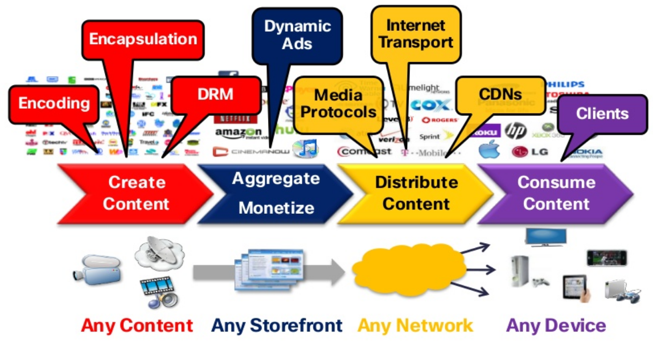
Open Digital Media Value Chain
Contribution, production
Distribution, consumption
Slide – Christian Timmerer, bitmovin, Alpen-Adria-Universität

Slide 20
Open Digital Media Value Chain

Slide 21
What is Broadcasting?
Broadcast = delivering information to many receivers simultaneously
Examples of broadcast information:
• Audio – speech, music • Video – moving images • Data – subtitles, metadata • Control signals – synchronisation, timing
All broadcast systems ultimately transmit information as signals.

Slide 22
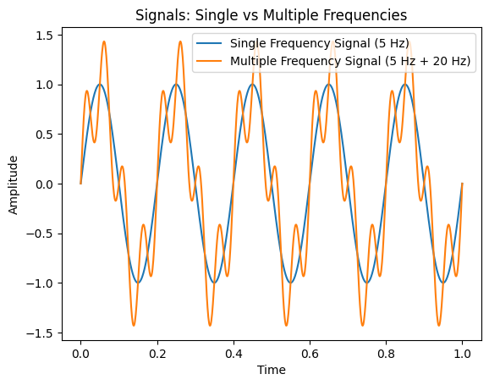
Everything in broadcast — audio, video, data — is ultimately a signal.
Notes:
Signal Fundamentals
In the first tutorial we will explore:
• Frequency • Wavelength • Period • Bandwidth
using MATLAB signal visualisation.

Slide 23
Why MATLAB for Signal Analysis?
Key Reasons
Widely used in research and engineering
Standard tool for signal processing and communications
Powerful simulation environment
Easy to model and analyse signals and systems
Matrix-based computation
Extremely efficient for manipulating signals and data
Visualisation tools
Quickly plot and analyse waveforms and spectra
Easy access for students
BCU provides MATLAB campus licence and MATLAB Online

